Slide 1
CNAT
sdmay20-51
Brandon Elizondo, Kirkland Keith, Suzanna Gudivada, Austin Sehnert, Benjamin Zaley
http://sdmay20-51.sd.ece.iastate.edu/
In Motion Care, LLC
Dr. Daji Qiao
sdmay20-51: Suzanna Gudivada
Notes:
Suzie: Welcome to team 51’s presentation, our project is CNAT. Our client is a start-up company InMotionCareLLC.
We are a team of five Computer Engineers: Brandon Elizondo, Kirkland Keith, Suzanna Gudivada, Austin Sehnert and Benjamin Zaley.

Slide 2
Problem Statement
The healthcare industry is in a transitional period
A care plan details how to care for each resident
Current care plans issues:
Large amounts of paper
Multiple changes a day
Confusion between different versions
It is difficult to keep healthcare staff accountable the time spent in residents’ rooms
Moving to a web application helps alleviate these problems
sdmay20-51: Austin Sehnert
Notes:
Austin:
Currently the healthcare industry is in a transitional period between using physical paper for records of patient health data and using online digital systems. The care that patients and residents have is recorded in physical paper packets called “care plans”. Care plan includes things like the diet of residents, transportation devices like a cane or a walker, and other instructions for the care of residents. Using these lengthy paper packets not only wastes a lot of paper, but poses a problem when the care of a resident changes. The changes made by one nurse won’t be updated for other nurses until a new packet if printed off for every nurse and there can be confusion as to which version of the care plan should be used. There is also no way of holding healthcare staff accountable for making changes to these care plans by knowing which nurse made a change. There is also no way of keeping nurses and other healthcare staff accountable for the time they spend in each residents room. Moving to a web application that has a live updated digital care plan and the ability to visually track and view healthcare staff locations will eliminate these problems.

Slide 3
Project Overview
Build tools for administrative and tracking services
Provide system to register users
Implement access control based on job position
View location of employees wearing a tracking tag
Display important events for auditing/logging:
System changes
Care plan updates
sdmay20-51: Benjamin Zaley
Notes:
Ben:
CNAT is a suite of applications with an intuitive user interface that supports the administrative management of healthcare personnel, alongside facilitating digital care plans of residents within Green Hills Retirement Community.
With our application, administrative staff have the ability to create new employees with varying levels of access based on their position within Green Hills.
CNAT also has the capability to show the location of employees wearing a location tagging device. Dots representing the location of these tagged users will appear on a map.
Lastly, our application will have a logging feature that can show legacy information, allowing Green Hills to view previous changes to the care plan and system for the record keeping purposes.

Slide 4
Requirements
Functional:
Dashboard to select sub-applications
Resource tracker
Differentiate between staff and equipment
Employee
View, add, and edit
Care plan
View, add, and edit
Google Chrome
Non-Functional:
Maintainable
Use technology already in use by client
Scalable
Modular design implementation
Secure
Provide levels of access
Usable
Easily accessible and intuitively designed
sdmay20-51: Benjamin Zaley
Notes:
Ben:
For our functional requirements, we have built in a dashboard that leads to the other sub-applications within our program, creating a neat user interface for easy navigation.
One of our sub-applications is a resource tracker, which displays tracked individuals and equipment within the facility.
An employee sub application grants administrative users the ability to view a list of employee information, as well as create new users and edit existing user information.
Similarly, the Care Plan will allow permitted users to create, view, and edit care plans for residents within Green Hills.
As our application is web-based, we are targeting our deployment for google chrome as it is currently the most popular web browser.
For our Non-functional requirements, our application needs to be maintainable. Our client should be able to easily continue development on our project should they wish to.
With this in mind, we have accounted for scalability, as our application could potentially grow beyond the scope Green Hills.
Our application must also be secure. We are storing sensitive data among a variety of users, some with higher levels of access than others.
Finally our application must be usable to the average user, with an intuitive interface.

Slide 5
Potential Risks and Mitigation
Risk:
Communication and display of sensitive data
Employee passwords
Employee locations within facilities
Resident information (certain health factors)
Much of the functionality is reliant on communication between frontend, backend, and database.
Danger of one going out means data will not be accessible.
Mitigation:
Permission based access
Based on employee position
Use of login tokens and login timeouts
Password hashing
Access and modification audit records
sdmay20-51: Suzanna Gudivada
Notes:
Suzie:
Some risks we forsee are … and .. we can mitigate these risk by implementing ….

Slide 6
Constraints and Considerations
Initial lack of UI page mockups from clients
Changes in scope
Scalability of application and database
Availability of resources
COVID-19
sdmay20-51: Austin Sehnert
Notes:
Austin:
Some constraints we have experienced throughout this project are having a lack of UI mockups for some of the pages we were planning on building due to COVID 19. We have also had a change in scope multiple times throughout the project. Some things we have had to consider throughout the project is the scalability of the application and database as well as the availability of resources.

Slide 7
Resource & Cost Estimates
Google Computer Engine (Virtual Machine)
vCPU cost: 3.3174 ¢/hour
Memory cost: 1.2227 ¢/hour
Total cost: 4.5401 ¢/hour
Cloud SQL (Database)
Usage cost: 6.76 ¢/hour
Storage cost: 17 ¢/GB/month
sdmay20-51: Brandon Elizondo
Notes:
Brandon: Costs for this project have only been incurred by our client and have been relatively minimal
Running the server costs just over 4 and a half cents per hour
Running the database costs 6.76 cents per hour with a rate of 17 cents per gigabyte per month
The hourly costs only add up when we turn the services on for testing purposes.

Slide 8
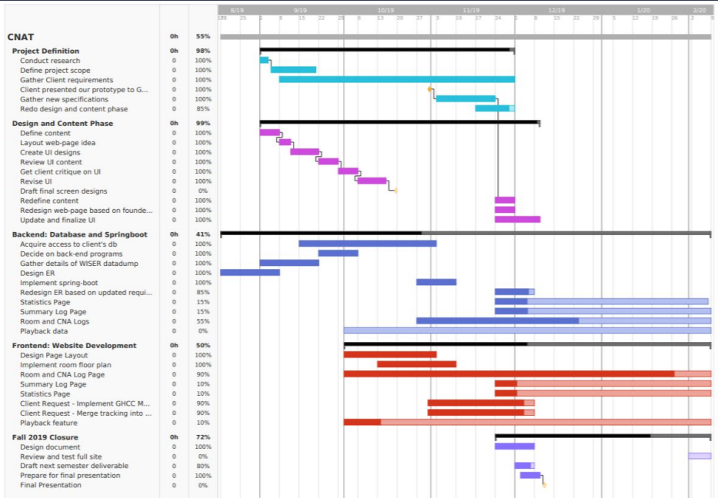
Project Schedule: Fall 2019
sdmay20-51: Suzanna Gudivada
Notes:
Suzie:
We used Gannt Charts to track our progress and to defined a timeline for our project based on the semester. This figure shows our schedule for Fall 2019. A lot of our project planning was done in Fall 2019 semester and we attended a hackaton to jumpstart our project development. We’ve created 3 different versions of Gannt charts in Fall 2019 due to changes in scope.

Slide 9
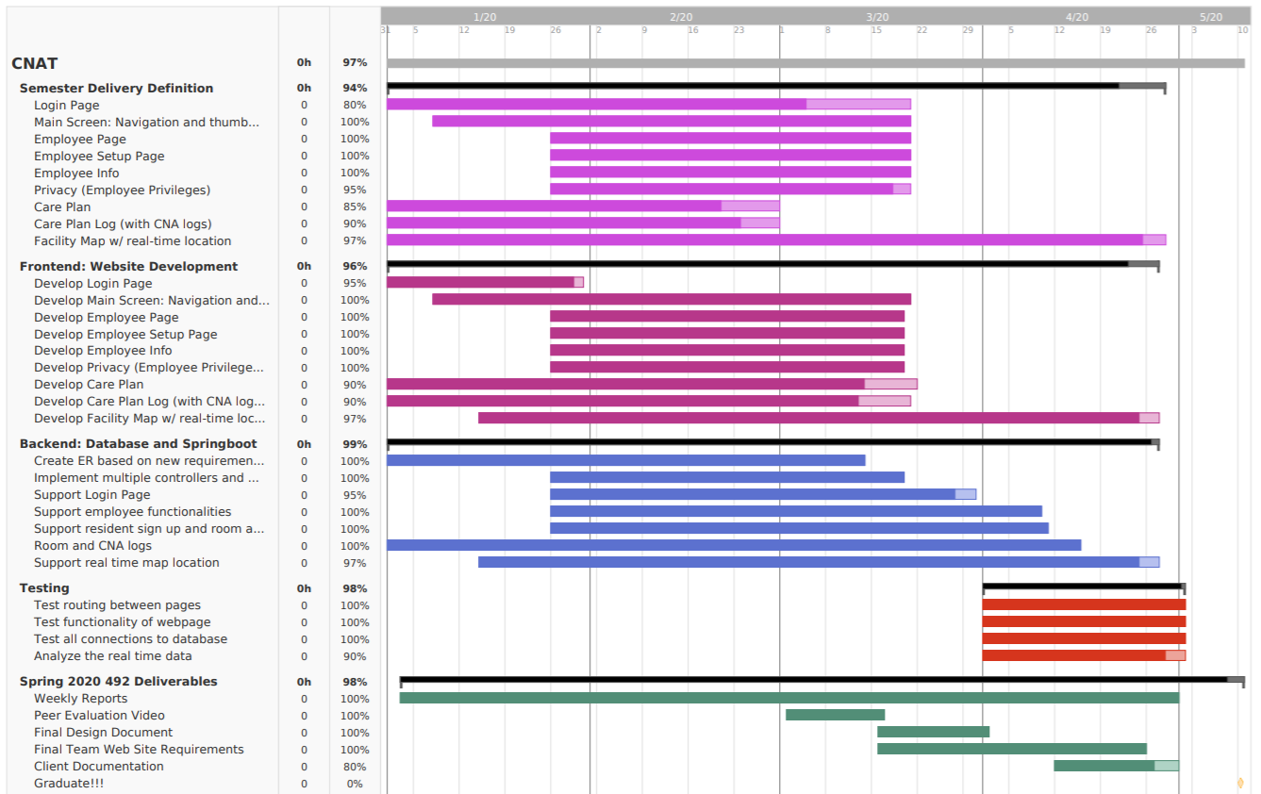
Project Schedule: Spring 2020
sdmay20-51:
Suzanna Gudivada
Notes:
Suzie:
This figure is our Spring 2020 project schedule. This semester we refined some deliverables but mostly used this semester to program and develop the web application.
We broke down tasks and set task deadlines to make sure to align the work flow smoothly between front-end and back-end teams. For each task, the darker shade is our current progress as you can see in the figure.

Slide 10
Deliverables
Initial Deliverables:
Care Plan with predefined fields from Green Hills
Admin/Employee pages
Hub/Home page
Real-time map of nurse and equipment locations
Login page
Field testing of map functionality within Green Hills
Deliverables due to COVID-19:
Viewable Care Plan
Admin/Employee pages
Hub/Homepage
Map showing legacy location data of nurses
No longer implementing the login page
Testing the live data displayed on the map webpage against data set provided by the client
sdmay20-51: Austin Sehnert
Notes:
Austin:
The original deliverables we were planning on getting to your client were...

Slide 11
Project Milestones
CNAT sdmay20-5151
Front-end
Pages
Hub
Map
Care Plan
Employee
Networking
API requests
Socket connection
Back-end
API
Database Connection
SQL Query Constructions
HTTP Requests
Map Websocket Connection
Database Schema Corrected and Implemented
sdmay20-51: Kirkland Keith
Notes:
Kirk - Even with the multiple scope changes throughout our project, including those due to COVID-19, our group has accomplished multiple things. On the front-end, we have successfully created the hub page, linking to our Map, Care plan, and administrative pages. Alongside this, the front-end has created all relevant HTTP requests and websockets needed to communicate with the back-end.
On the backend, we have successfully created an API for use by the front-end . This includes having our database up and running and all of our needed SQL queries constructed. Networking on the back-end is done as the opposite side of that done on the front-end. And finally we have fully corrected the client’s pre-existing DB and immmple,

Slide 12
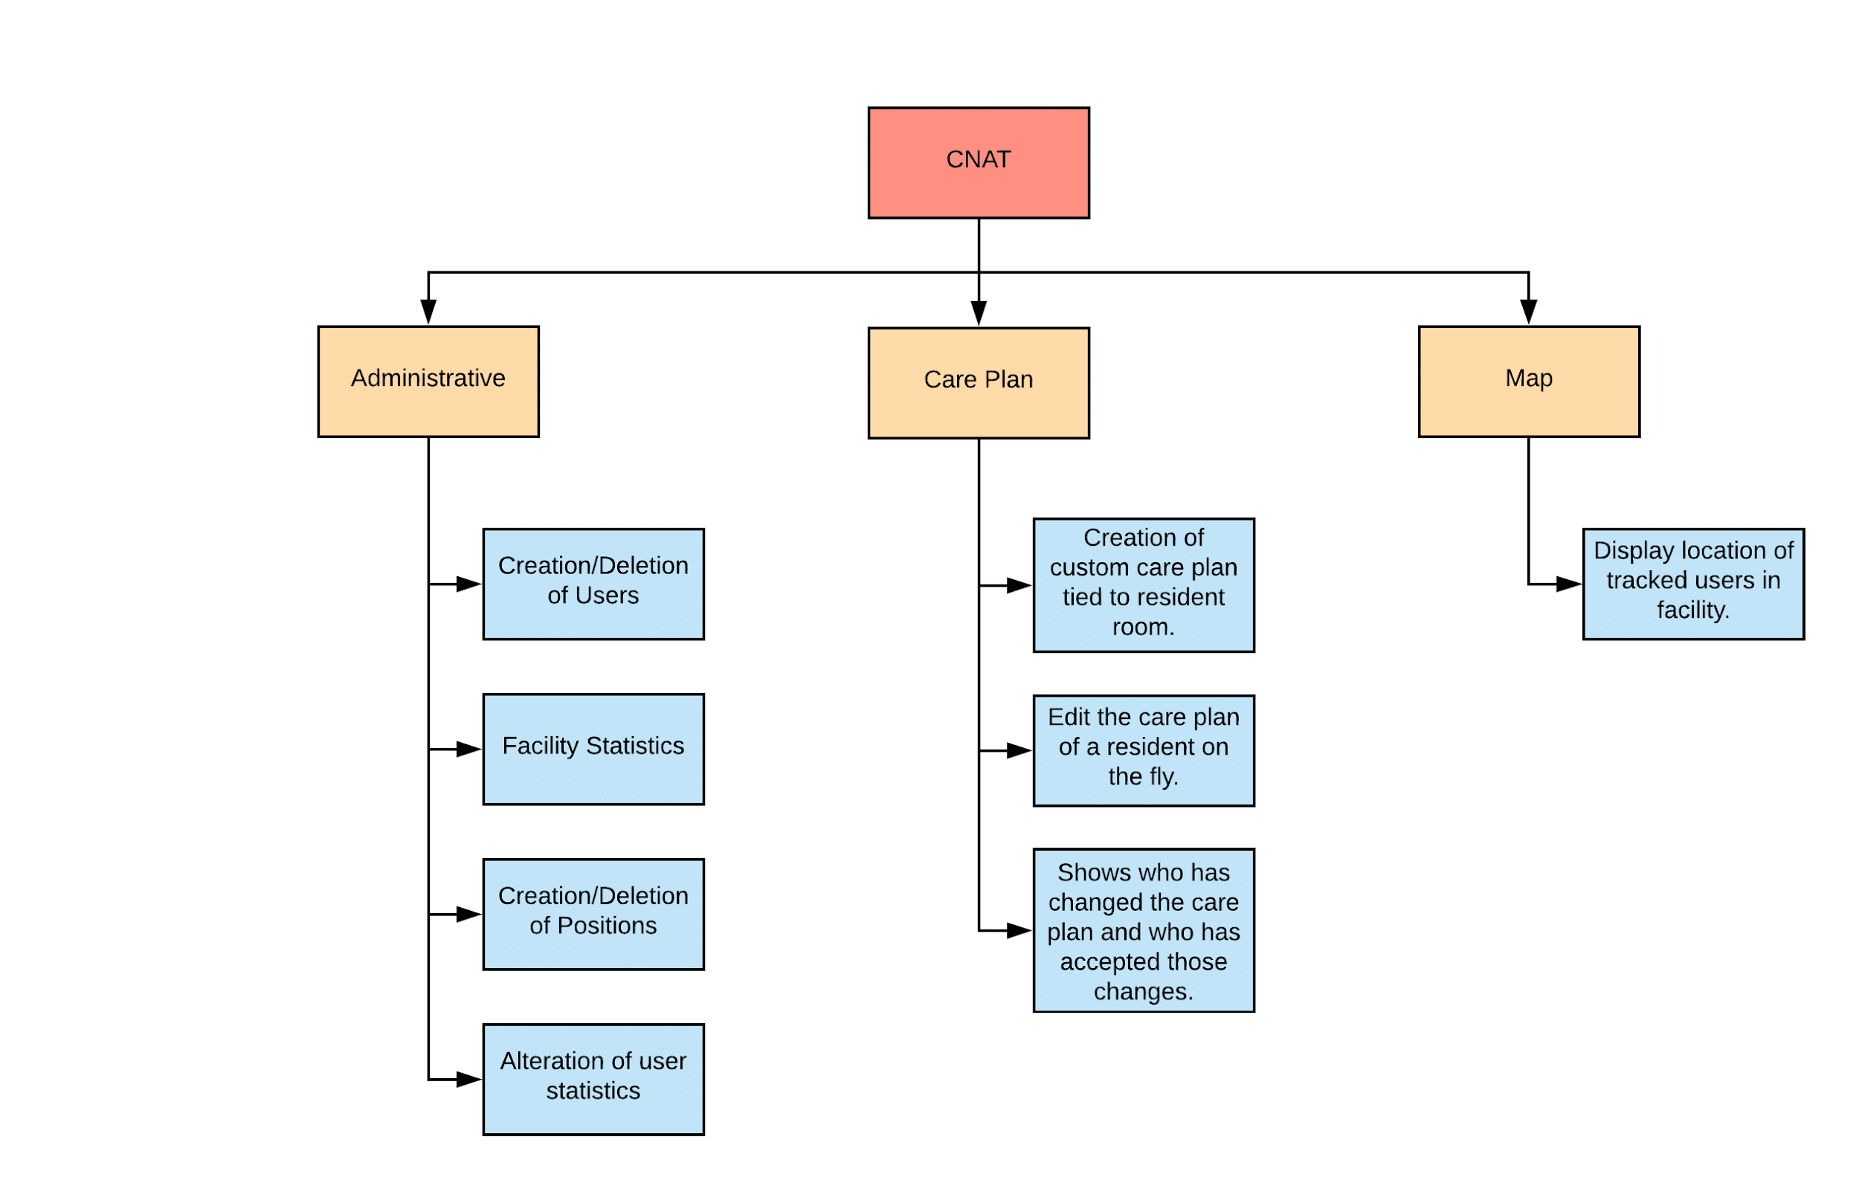
Functional Decomposition
Figure: Functional Decomposition of CNAT webpage
sdmay20-51: Brandon Elizondo
Notes:
Brandon: The bulk of our application can be split into three main functionalities: Administrative, Care Plan, and the Map.
The administrative section deals with the creation, editing, and viewing of employee data
The Care plan shows current health and care needs for residents in their rooms
And the map will display the location of location tags throughout the facility.

Slide 13
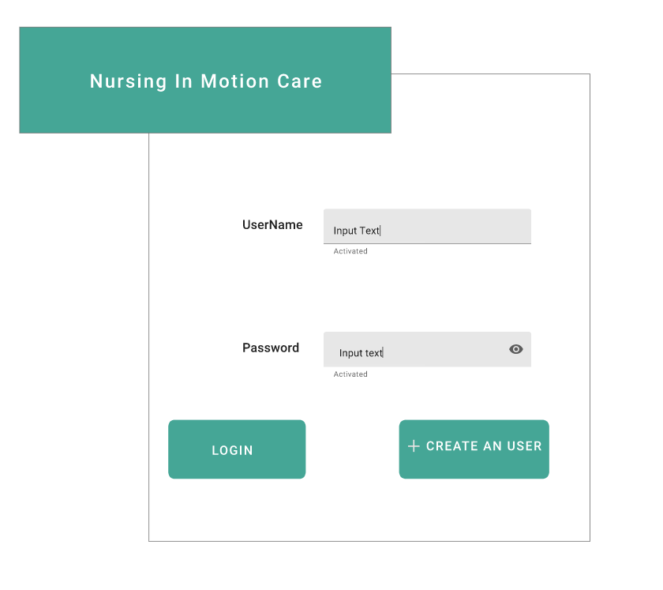
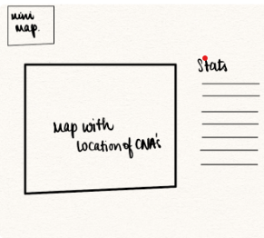
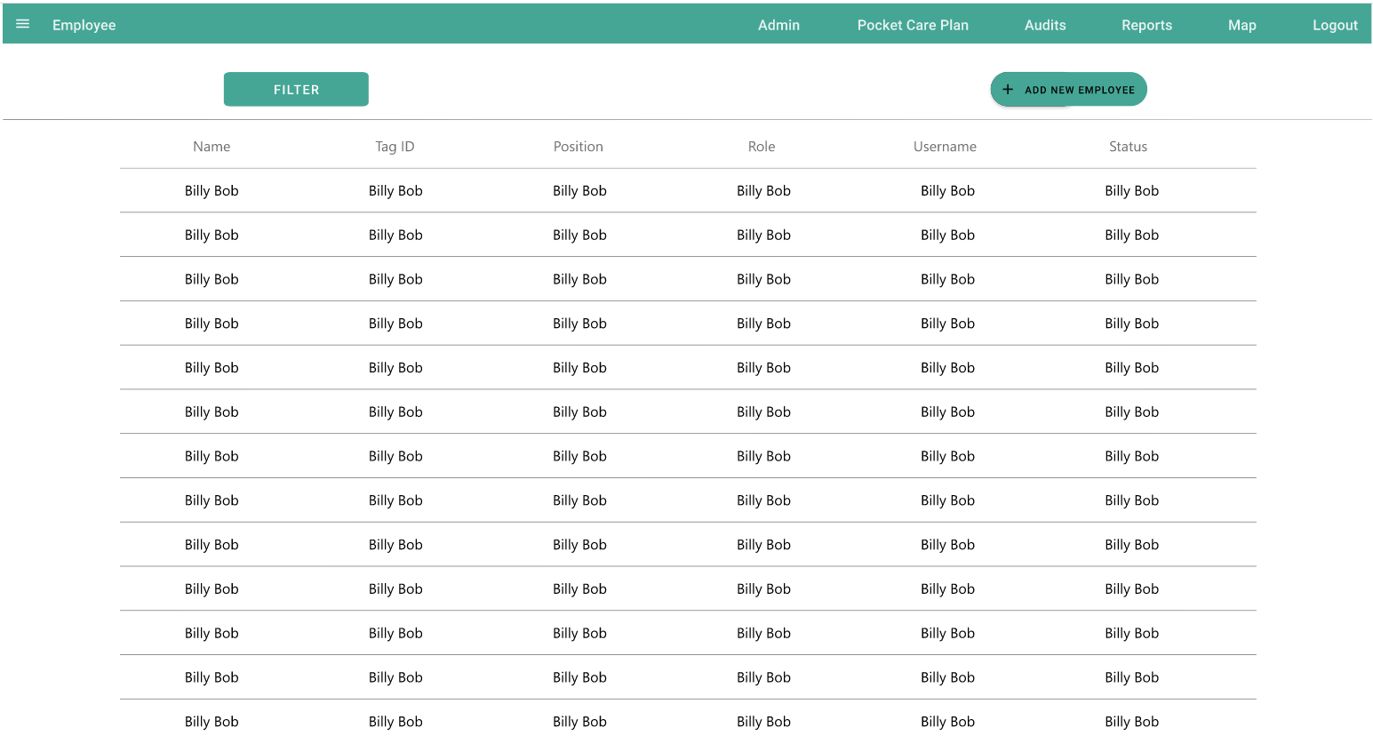
Conceptual Sketch
Figure 1. Login Page
Figure 2. Admin: Employee
Figure 3. Map page
sdmay20-51: Suzanna Gudivada
* Screen Designs provided by In Motion Care LLC
Notes:
Suzie: The screen sketches shown above were provided to us by our client as final screen designs after multiple sessions of decisions about components, tables and utility of the screens. Being involved with our client while designing and determining the above screens, helped us attain an easier approach to implementation. Some major functionalities we are providing can be shown in the above images: A login/sign up screen, Administration functionality where employees are assigned titles, positions and roles, We will provide a real time location of the CNAs on a scaled map of the facility.

Slide 14
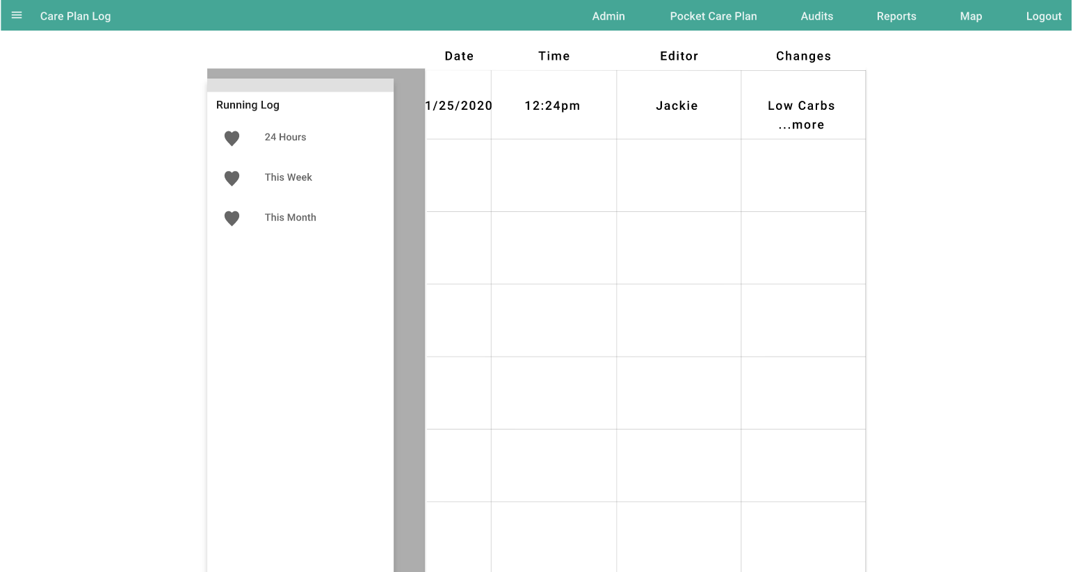
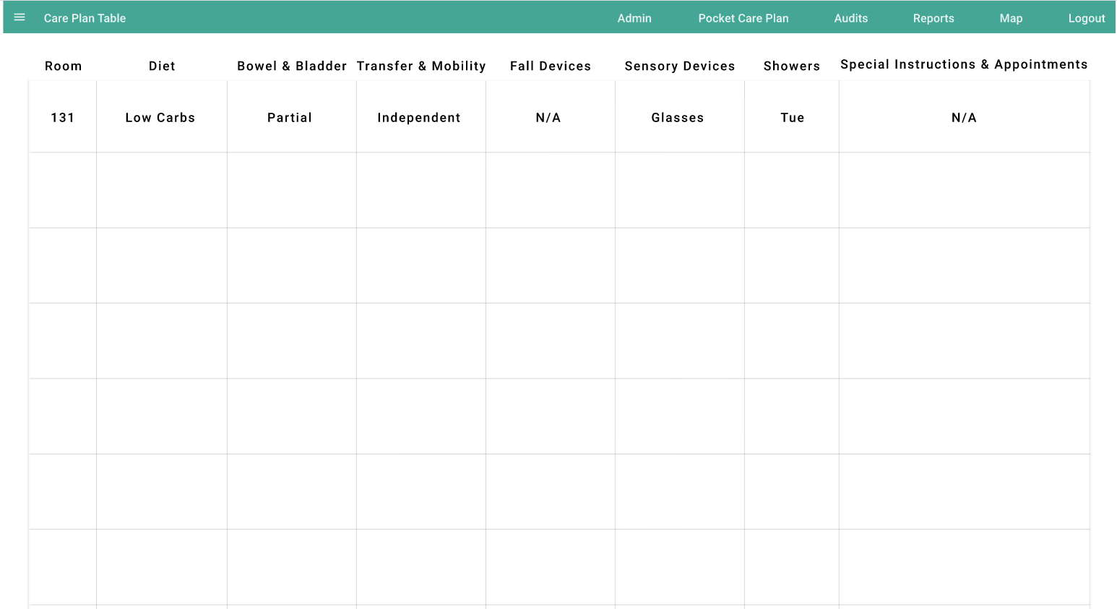
Conceptual Sketch
Figure 4. Care Plan Log
Figure 5. Care Table
sdmay20-51: Suzanna Gudivada
* Screen Designs provided by In Motion Care LLC
Notes:
Suzie: Another huge part of our deliverable was the integration of Care Plan into our webpage. A basic structure of the careplan was in place prior to our involvement into the project, it was developed in javascript. As per our clients requirements of using ReactJS, we converted the old application and integrated it to our webpage and built more functionality as we progressed.

Slide 15
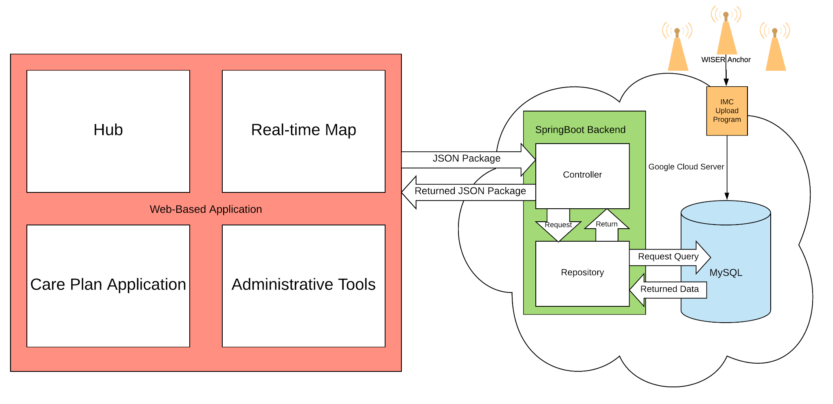
Detailed Design
Figure: Detailed Design Flow
sdmay20-51: Kirkland Keith
Notes:
Kirkland:
Our information is fed from the Wiser Anchors, which is supplied to the database through In Motion Care’s existing upload program.
From here, our database stores all relevant user, care plan, and positional information. The front end of our application supports four main functionalities… … … …, Any request made by the frontend are transformed into JSON packages and sent to our SB backend, which is hosted on a google cloud server. The controllers within SB turn requests into Queries to our MySQL DB, which fetches and returns the requested info.
Reversing the process, the data is returned to the frontend, and the JSON package is unwrapped and displayed to the user.

Slide 16
Technologies
Used
React JavaScript
Redux
Bootstrap
Java (Spring Boot)
MySQL
Google Cloud
Websockets and STOMP (simple messaging protocol)
Postman
Wiser Systems API
Gitlab
sdmay20-51: Austin Sehnert
Notes:
Austin:
JS and CSS frameworks for front-end
Java frameworks and MySQL for the back-end
Postman for testing
Wiser Systems for location fetching
Gitlab for code repository

Slide 17
Frontend Implementation
ReactJS:
User Interface
Bootstrap:
Customization
Redux:
State Manager of the UI
Websockets:
Import datasets
sdmay20-51: Suzanna Gudivada
Notes:
Suzie:
Our webpage’s user interface is developed using React which is a JavaScript framework. We used Bootstrap to implement CSS and JavaScript type customization. We utilized Redux for managing the state of our web application. To handle the heavy flow of location data, we used websockets protocol for communication between frontend and backend.

Slide 18
Back-end Implementation
CNAT sdmay20-51
Spring Boot Server
Supports a Representational State Transfer (REST) API
Allows easy control of information flow
Supports Cross-Origin Resource Sharing
Allows secure requests and data transfers between front-end and back-end
Broken into three key sets of components:
Controllers: Controls all activity that goes through its given URL and functions
Websockets
HTTP Requests
Models/DTOs: Classes made to present and store data in an easy, accessible way
Repositories: Access points for our database
sdmay20-51: Kirkland Keith
Notes:
Kirkland
We decided to implement our backend using Spring Boot Server. Spring Boot was chosen as it supports a REST API which allows for easy control of the flow of requests and information. It also supports CORS filtering, or Cross-Origin Resource Sharing, which helps to keep our information secure as it moves between the front and back-ends.
Our back-end has been broken down into three key sets of components. When a request is made from the front-end, that request is picked up by our controllers based on the request URL. These requests may come as either a standard HTTP request, or through the use of websockets. The controller will push that request towards its respective repository, which acts as an access point to our database and houses are SQL queries. Upon receiving the relevant data, it is place into either models or data transfer objects which help us to format the data for delivery to the frontend.

Slide 19
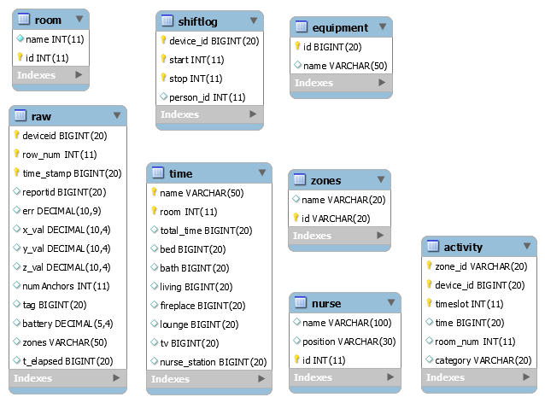
Original Database
No relationships between entities
Data fields that are underutilized
Replication of similar data amongst different entities
Lack of care plan support
Inability to expand
sdmay20-51: Benjamin Zaley
Notes:
Ben:
When we began our project, the original database was built primarily for testing and capturing data from WISER’s sensors.
Data was initially injected directly into a table through IMC’s upload program. This database lacked relationships between tables, causing an issue with duplicated data, which in turn bloated the amount of information being stored and did not allow the ability to expand. Similarly, there were several fields within the database that were underutilized, or in some cases, not used at all. This database also lacked the ability to support the care plan portion of our application.

Slide 20
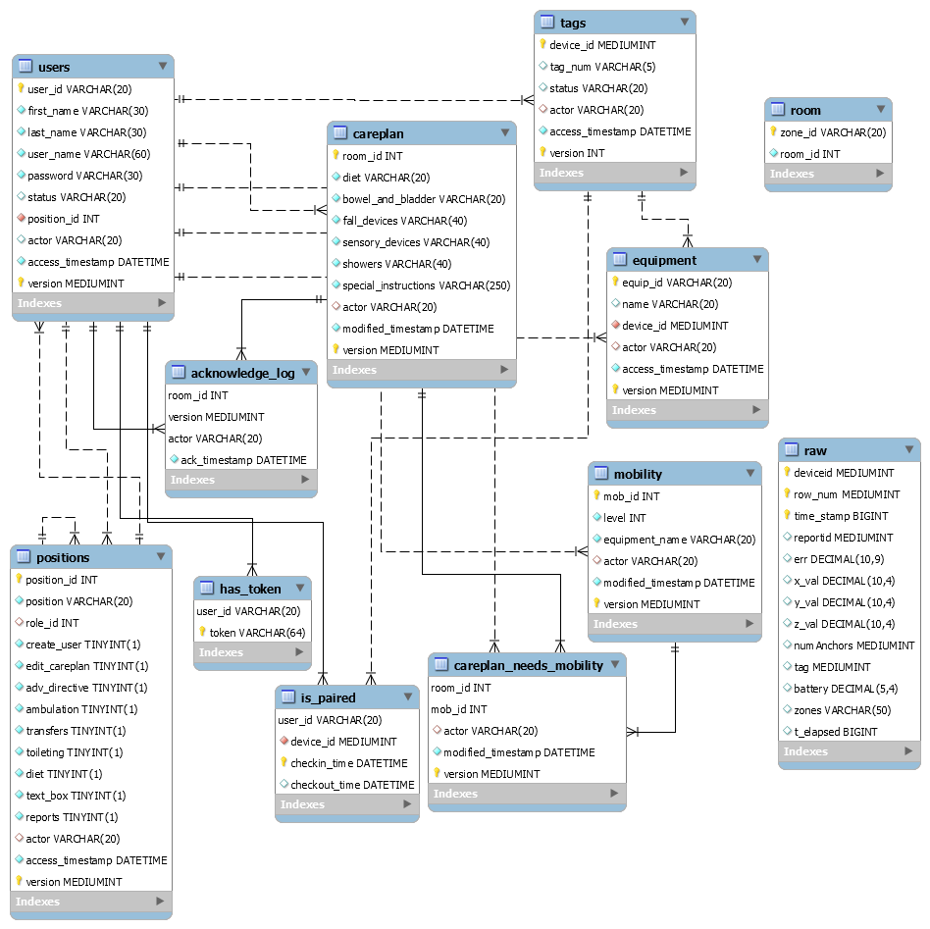
Current Database
Relationships between entities to eliminate duplicate data
Created permission structure for users
Implemented log system to query legacy data
Built-in care plan structure
Easily expandable without having to alter schema
sdmay20-51: Benjamin Zaley
Notes:
Ben:
As part of our project, we rebuilt In Motion Care’s existing database to accommodate the scope of our project. Relationships were added amongst the tables within our database to remove the replication of data. By adding a user entity, we were able to create a permission structure that allows varying levels of access throughout our application. We have also created a logging function. Each table with the capability to edit or create has an associated version to account for legacy information. Should Green Hills need to look back at system changes in the past, they will be able to see when and who created a new item in the database.
Support for the care plan was also built into our database, which supports the logging capabilities as well. We’ve built the ability for IMC to expand the care plan portion of our database in the future when they have access to more information from Green Hills.

Slide 21
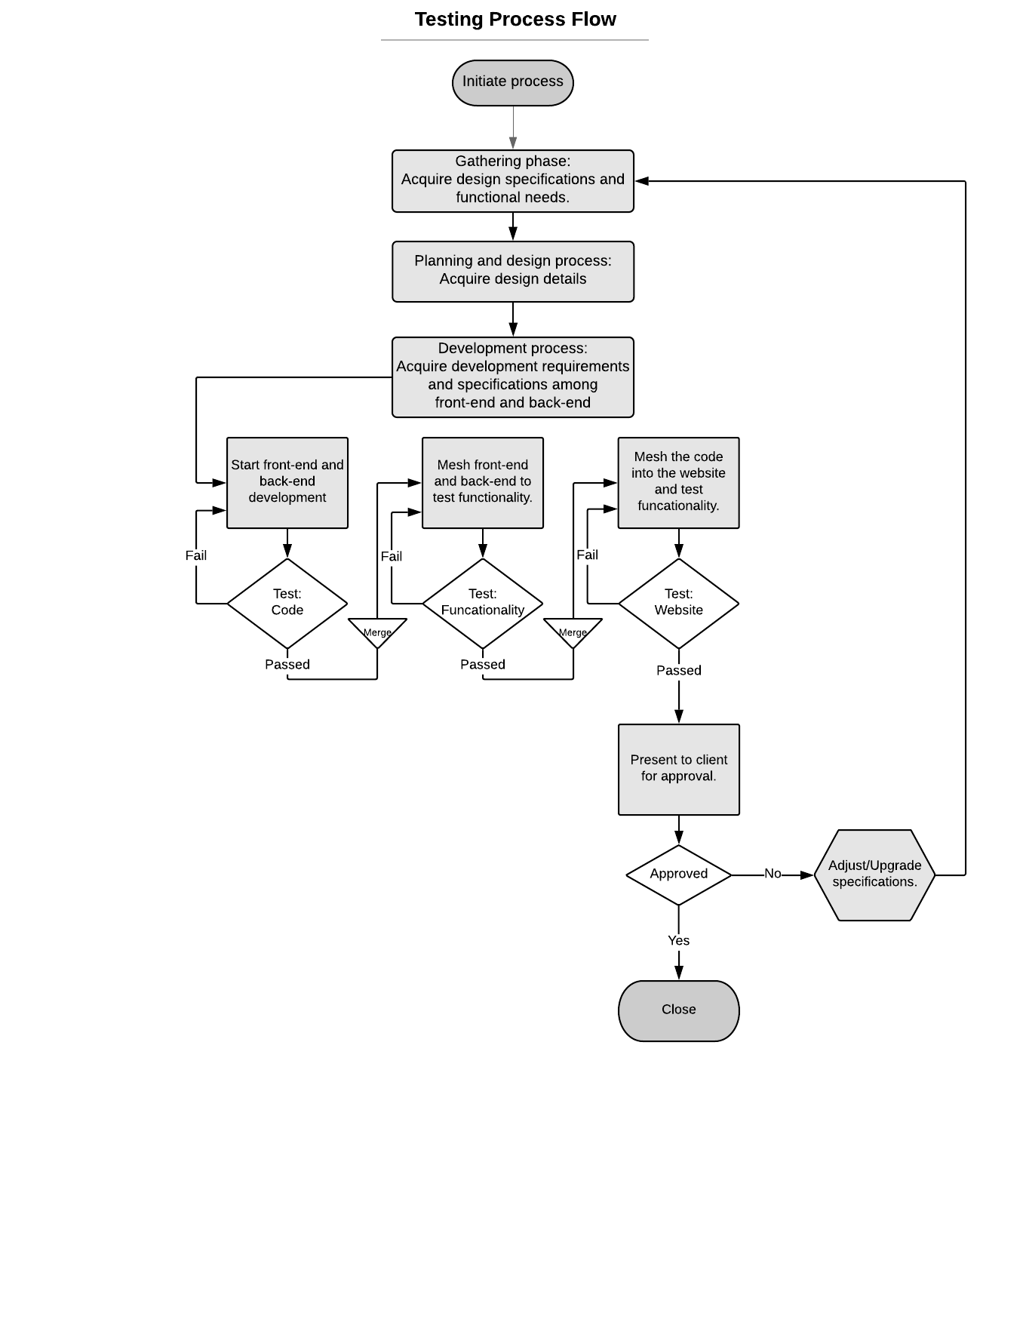
Project Testing
Functional Testing:
Postman
Non-functional Testing:
Reused legacy data to simulate live data
Test Results:
Postman used to test HTTP requests
Compared results to expected values based on mock data
Tested Websockets by running simulation script on the database
sdmay20-51: Kirkland Keith
Notes:
Kirk: When working on any function implementation, we follow this process flow on the right. Our process begins with analyzing any design specification or need requested by the client. Planning will take place around this analysis before we begin development.
To start we simultaneously begin working on the function from two fronts, the back-end and front-end. Separately, we create our code, testing it in stationary environments. The back-end, for example, utilizes Postman to mimic the requests coming from the front-end. The information received on Postman or pushed to the database are then compared to the expected values.
Once this initial testing is complete, we mesh the front-end and back-end together in order to test the functionality of the two systems in tandem. During this stage, we used legacy data and scripting to simulate live data for the map and other pages. Upon completing our testing, the function is presented to our client for approval. Depending on their answer, we go back to adjust the function or begin our focus on the next one.

Slide 22
Prototype Implementation
(Demo)
sdmay20-51: Brandon Elizondo
Notes:
Up next, we have a short-pre-recorded video that will demonstrate what we have currently implemented in our system.

Slide 24
Engineering Standards and Design Practices
ISO/IEC/IEEE International Standard - Systems and software engineering--Measurement process, IEEE 15939-2017
ISO/IEC/IEEE International Standard - Systems and software engineering -- Software life cycle processes, IEEE 12207-2017
ISO/IEC/IEEE International Standard for Software Engineering - Software Life Cycle Processes - Maintenance, IEEE 14764-2006
Health Informatics—Point-of-care medical device communication Part 10201: Domain Information Model, IEEE Std 11073-10201-2018
Software and Systems engineering —Software testing — Part 4: Test Techniques, IEEE 29119-4:2015(E)
sdmay20-51: Austin Sehnert
Notes:
Austin

Slide 25
Thank you!
Questions?
Sdmay20-51 Suzanna Gudivada
Notes:
Suzanna: Thank you , questions?

